Slide 1
Lesson 2
E115 – Programming and Data analysis

Slide 2
Lesson objectives
At the end of the lesson, you should be able to:
Declare and use the following types of variables:
Integer
Double
String
Make use of the “For… Next” loop to go down the rows and across the columns in an Excel table

Slide 3

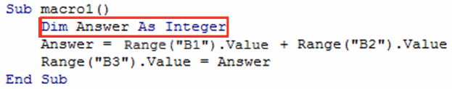
Using variables
Demonstration: Add the numbers in Cells B1 and B2 and display it in Cell B3.
Code that does this:
“Answer” is a variable. Variables are names that refer to items of data.
“Dim Answer As Integer” is a variable declaration.
We are declaring that “Answer” is an Integer variable. (“Dim” stands for “Dimension”)
It is good programming practice to declare variables before using them.

Slide 4
Rules for naming variables
Reserved words cannot be used for naming variables (Refer to reserved_words.docx in resource).
First character must be an alphabet.
Uppercase and lowercase characters are treated as the same character, e.g. “student” and “Student” are the same variable
No spacing or full stop is allowed within a name e.g. “first student” cannot be used as a variable name
No special characters (e.g. !,#,$,%,&) are allowed in a variable name
Examples of acceptable names for variable: student1, first_name, lblName, strCount

Slide 5
Common data types in VBA
Data type | Acceptable range of values | Example
Byte | 0 to 255 | Dim num as Byte num = 45
Integer | -32768 to 32767 | Dim number as Integer number = 45
Long | -2 billion to 2 billion | Dim bignumber as Long bignumber = 45
Double | 5 x 10⁻³²⁴ to 1.8 x 10³⁰⁸ | Dim dotdotdot as Double dotdotdot = 5.6
Boolean | True/False | Dim result as Boolean result = False
String | 1 to 65400 characters | Dim name as String name = “John”

Slide 6

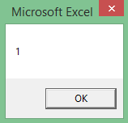

Exercise
Type the numbers into Cells B1 and B2 as shown.
Write a macro to create message box that displays the result of subtracting Cells B1 from B2. Your macro should work every time regardless of what numbers you put into Cells B1 and B2.
Answer:

Slide 7

Referencing the contents of a cell
Range(“B1”).Value refers to the value stored in Cell B1 (circled in red):
Alternatively, we can also use Cells(1,2).Value to refer to the value in B1.
Column number
Cells(1,2).Value
Row number

Slide 8


Use of variables
Variables are used to store data.
E.g. To display the word “useful” in Cell A1,
We can either write
Range(“A1”).Value = “useful”
Or write
“A” & RowNumber is the same as “A1” because RowNumber = 1
This is useful when the row number is not a pre-determined fixed number. See example on next slide.

Slide 9
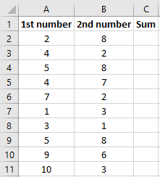
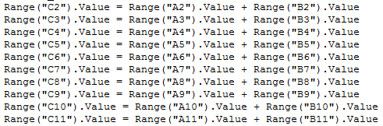
For … Next loop
Example: Add the numbers in Columns A and B and display the answer in Column C.
You can either do this with:

Slide 10
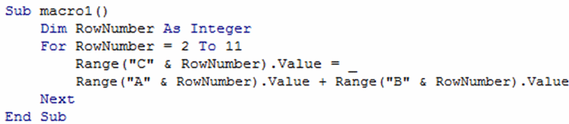
For … Next loop
Or you can do it with
Which do you prefer?

Slide 11

Explaining the code
This is commonly known as a “For” loop
The code in between “For” and “Next” will be executed multiple times.
How many times?
Ans: 10 times

Slide 12
Finding the last row in a column
What happens if we do not know the row number of the last row in the table?
Recall: Code to get last row in Column A:
Range("A:A").End(xlDown).Row
Instead of For RowNumber = 2 to 11 we can write
For RowNumber = 2 to Range("A:A").End(xlDown).Row

Slide 13
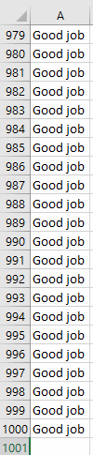



Exercises
Create a “For… Next” loop to write the words “Good job” into cells A1 to A1000.
Answer:
Create a “For… Next” loop to write the words “Good job” into cells A1 to XFD1.
Answer:

Slide 14



Nested For… Next loop
You can have a For loop inside another For loop.
Example: Colour the cells below yellow.
Notes:
Good practice: Indentation

Slide 15
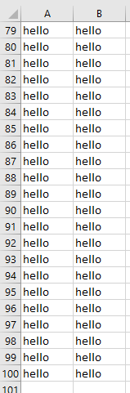

Exercises
Use a nested For Next loop to write the word “hello” into the first 100 rows of columns A and B as shown:
Answer:

